Slide 1

GIT Introduction
Basics if Git and Github

Slide 2
What is
Git
Is a distributed, open source Version Control System, designed for speed and efficiency.
GIT?

Slide 3
Git – simple & powerful
Notes:
Git - simple and powerful system

Slide 4
Git – simple & powerful
git push …
git init
git tag …
git commit …
git pull …
git remote …
git branch …
git diff …
git checkout …
git add …
git log …
git fetch …
Notes:
Often, people try to teach Git by demonstrating a few dozen commands, and then yelling…

Slide 5
What is
A system that records changes to a set of files over time. Essential for a project development being worked on by multiple people.
Why do we need it?
Keep every version of the file(source code, image…)
Work easily with several developers.
Compare changes revert files back to the previous state…
VCS?
1
2
3

Slide 6

WHY GIT?
Git manages files in a tree of files over time
Git is optimized for
Distributed development
Large file count
Complex merges
Making trial branches
Being fast and robust
Git is not optimized for:
File permission/ownership
Unrelated individual files
1
2
3

Slide 7
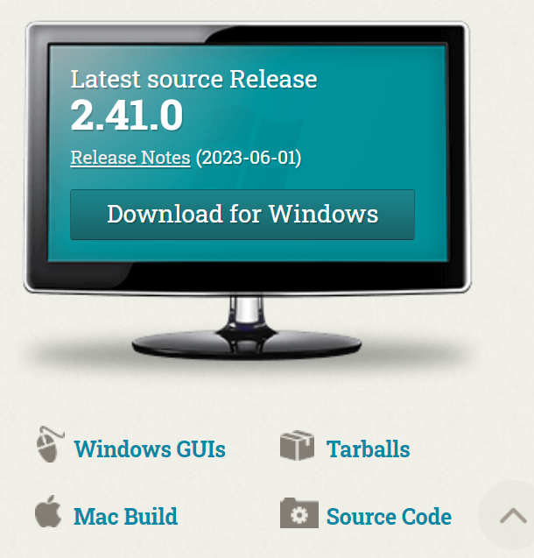
Go to: https://git-scm.com/ and Download the setup file…

Slide 8
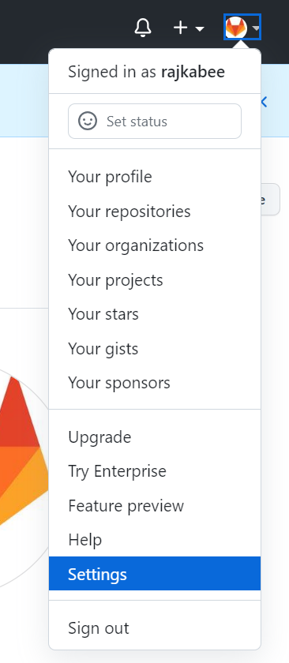
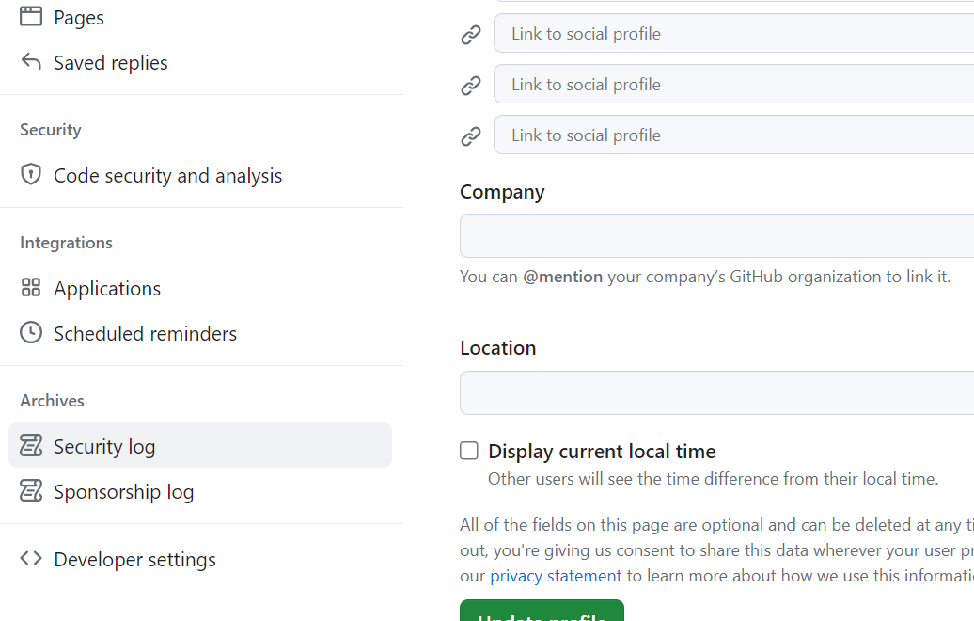
First Time Setup
Go to settings in github
Go to Developer Settings

Slide 9
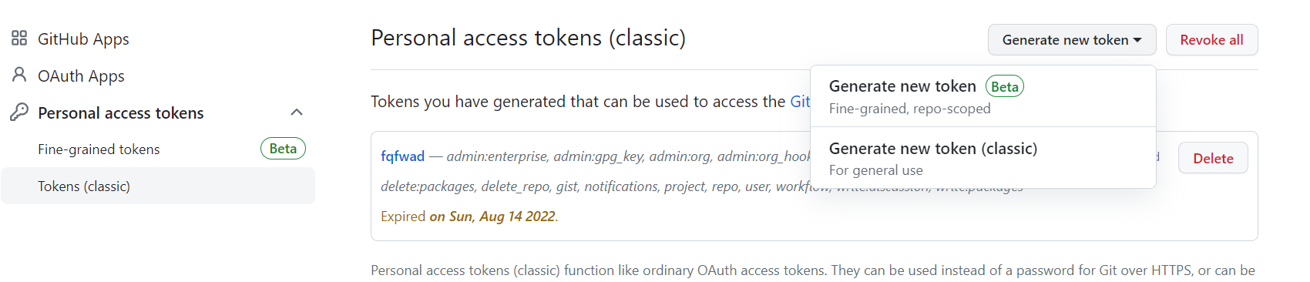
First Time Setup
Go to: Personal Tokens / Tokens / Generate new token
And copy the token to your notes…

Slide 10
First Time Setup
You can view all of your settings and where they are coming from using:
git config --list --show-origin
The first thing you should do when you install Git is to set your user name and email address. This is important because every Git commit uses this information, and it’s immutably baked into the commits you start creating:
git config --global user.name "John Doe"
git config --global user.email johndoe@example.com
When asked for username and password :
Use the token noted earlier as the password

Slide 11
REPOSITORY
Contains a collection of files and directories
Records their change history and tracks their status and version
Local Repository
Resides on a local machine of an individual user
Remote Repository
Resides on a remote server that is shared among multiple team members
git init [project_name]
git clone [remote_repo_url]

Slide 12
COMMIT
An operation to record changes
Enables you to consult previously committed changes
Order your workflow and identify every patch(Update)
git commit -m ‘[message]’
Make a commit with a description
git status
Lists new/modified files to be committed
Git diff
Shows file differences not yet staged

Slide 13
WORKING TREE AND INDEX
Working Tree
Consists of files that you are currently working on
Index
Is a staging area where new commits are prepared. It is an instance between a repository and a working tree
git add .
git add –all -stage all changes to index
git add [file_name] -stage a given file
git add [directory] -stage changes in a directory

Slide 14
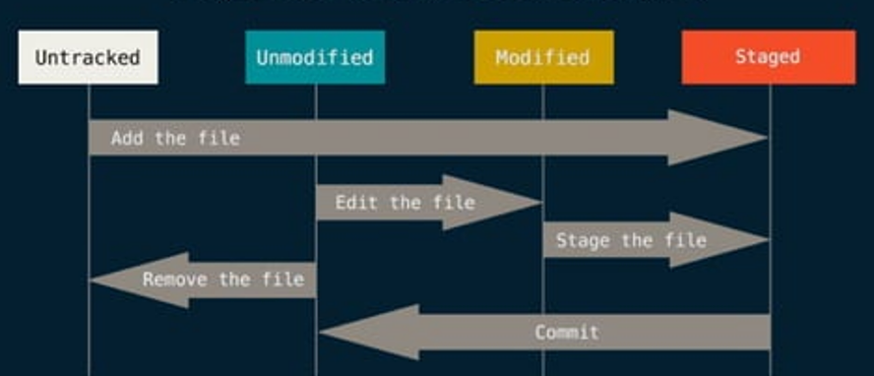
Changes made to the working tree will not be committed directory to the repository

Slide 15
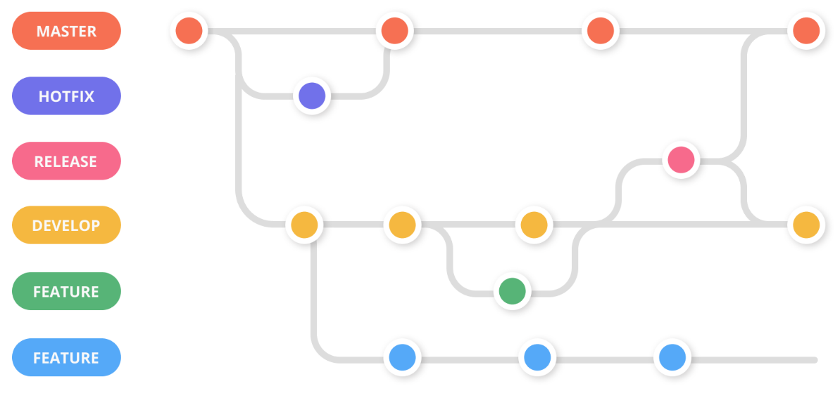
BRANCH
An independent line of development
Perfect for working on new features or bug fixes
Each repository has a master branch by default
git branch
List available branches
Git branch [branch_name]
Add new branch
Git checkout [branch_name]
Switch a branch

Slide 16
MERGE
An operation that applies the changes of a branch onto the Master branch
git merge [branch_name]
Merge a specified branch

Slide 17

CLONE
If a remote repository already exists, you can fetch a copy from your local machine and start working on it.
git clone [remote_url]
Copy a remote repository on your local machine

Slide 18
PULL
Pull operation from remote repository to your own local repository
Unlike clone, pull downloads the latest version history from a pre defined remote
git pull [remote_url]
Pull changes from a remote repository on your local machine

Slide 19
PUSH
An operation that enables you to share your changes
It simply moves the staged changes from the local repo to the remote repo
git push [remote_url] [branch]
Push staged changes to a remote repository in a specified branch
Your push to the remote repository will be rejected if your local repository is out of date, possibly because there are some updates that are on the remote repository added by others that you do not have locally yet. –it is called a CONFLICT
If that is the case, do a pull to grab the latest changes from the remote repository before you are allowed to push.

Slide 20
PUSH
An operation that enables you to share your changes
It simply moves the staged changes from the local repo to the remote repo
git push [remote_url] [branch]
Push staged changes to a remote repository in a specified branch

Slide 21




Famous Git platforms
Git is not Github!

Slide 22
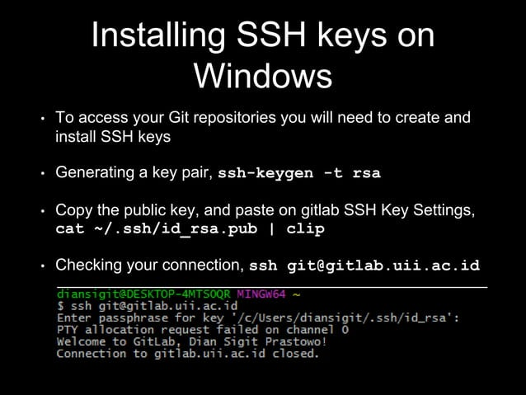

Slide 23


Snapshots
working
Notes:
Start project in directory named “working”.
Try to write one feature at a time.

Slide 24
Snapshots
working
working.copy
Notes:
Complete a self-contained portion of a feature →
Duplicate the entire working directory, to *archive* the current state.

Slide 25

Snapshots
snapshot.0
working
working.copy
Notes:
Going to make *more* copies of the working directory, so you rename the copy to “snapshot.0”.
After: *never* again change code in “snapshot.0”

Slide 26
Snapshots
snapshot.0
snapshot.1
working
Notes:
After the *next* chunk of work:
Another copy → name “snapshot.1”, and so on.

Slide 27
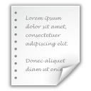
Snapshots
snapshot.0
snapshot.1
working
message
message
2019-05-20 12:34:56
Initial version
2019-05-21 23:45:01
Introduced a new foo, and reset the bar to xyzzy.
Notes:
Remember the changes made in each snapshot → add a special file named “message” to each snapshot directory.
Contains:
- Summary of the work that you did
- The date you did it
Find a specific change →
search the message files in previous snapshots

Slide 28
Branches
...
snapshot.0
snapshot.1
working
snapshot.99
Notes:
After some time:
- release candidate starts to form
- decide to release “snapshot.99” as Version 1.0

Slide 29
Branches
...
snapshot.0
snapshot.1
working
snapshot.99
Notes:
Package “snapshot.99” and distribute as Version 1.0.
Your users love it, and you push forward, determined to make the next version an even bigger success.

Slide 30
Branches
...
snapshot.0
snapshot.1
working
...
snapshot.99
snapshot.109
Notes:
Keep adding new features.
Make 10 new snapshots.
Your VCS: faithful companion.
Old versions are there when you need them & can be accessed with ease.

Slide 31
Branches
...
snapshot.0
snapshot.1
working
...
snapshot.99
snapshot.109
Notes:
But not long after the release, bug reports from Version 1.0 start to come in.

Slide 32
Branches
...
snapshot.0
snapshot.1
working
...
snapshot.99
snapshot.109
Notes:
In order to fix the bugs in Version 1.0:
copy “snapshot.99” to “working” so that your working directory is at exactly the point where Version 1.0 was released.
You then make the required fixes.
It is here that a problem becomes apparent:

Slide 33
Branches
...
snapshot.0
snapshot.1
working
...
?
snapshot.99
snapshot.109
?
snapshot.110
Notes:
The VCS deals very well with linear development.
*but* for the first time, you need to create a new snapshot that is not a direct descendant of the preceding snapshot.
“snapshot.110” does not follow “snapshot.109”
→ breaks the linear flow
→ cannot determine the ancestry of any given snapshot.
Clearly, you need something more powerful than a linear system.
Time to have a break, and you take a walk outside.

Slide 34
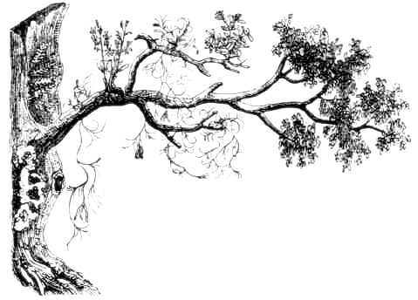
Branches
Notes:
Walk past oak tree, look more closely
Start looking at branch tip, and trace it back to the trunk.
The tree is a very complex structure, but the rules for finding your way back to the trunk are so simple, and perfect for keeping track of multiple lines of development!

Slide 35
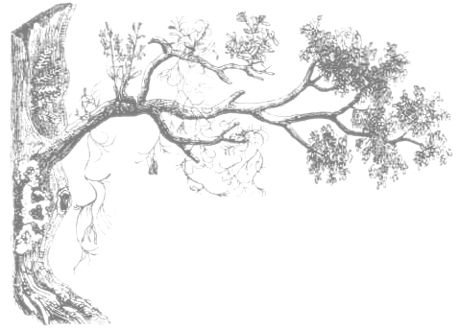

Branches
Notes:
You have another epiphany.
By looking at your code history as a tree, solving the problem of ancestry becomes trivial.

Slide 36
Branches
Notes:
You need each snapshot to point to the previous snapshot, also known as the “parent” snapshot.
Each snapshot has one parent, except for the very first snapshot.

Slide 37
Branches
snapshot.0
snapshot.1
message
2019-05-21 23:45:01
parent: snapshot.0
Introduced a new foo, and reset the bar to xyzzy.
Notes:
So how do you store this pointer to the previous snapshot?
Include the name of the parent snapshot in the “message” file you write for each snapshot.

Slide 38
Branch Names
snapshot.109
snapshot.110
working
snapshot.99
snapshot.1
snapshot.0
Notes:
That pointer enables you to easily and accurately trace the history of any given snapshot all the way back to the root.
Your code history is now a tree.

Slide 39
Branch Names
snapshot.109
snapshot.110
working
snapshot.99
snapshot.1
snapshot.0
Notes:
Instead of having a single latest snapshot, you have *two*: one for each branch.
non-linear history → sequential numbering system is less useful:
You cannot easily determine the latest snapshot, because you have *multiple* latest snapshots, one for each branch.

Slide 40
Branch Names
snapshot.X
snapshot.109
snapshot.X
snapshot.110
working
snapshot.99
snapshot.X
snapshot.1
snapshot.X
snapshot.0
Notes:
However, Creating new development branches has become so simple that you’ll want to take advantage of it all the time.
You’ll be creating branches for fixes to old releases, for experiments that may not pan out; indeed it becomes possible to create a new branch for every feature you begin!

Slide 41
Branch Names
snapshot.X
snapshot.109
snapshot.X
snapshot.110
working
snapshot.99
snapshot.X
snapshot.1
snapshot.X
snapshot.0
Notes:
But like everything good in life, there is a price to be paid:
You need some way to keep track of these branches, and which snapshots belong on which branch.

Slide 42
Branch Names
This is the “master” branch
snapshot.109
snapshot.110
working
This will be the “Version 1.0 Maintenance” branch
snapshot.99
snapshot.1
snapshot.0
Notes:
Every time you create a new branch you probably give it a name in your head.
(Identify the two branches)
Now, to find the snapshots on a branch, you only need to remember the *latest* snapshot on that branch.
The earlier snapshots is found by following the parent pointer from each snapshot.

Slide 43
Branch Names
snapshot.109
snapshot.110
working
snapshot.99
master: snapshot-109
v1.0-maint: snapshot-110
branches
snapshot.1
snapshot.0
Notes:
So, how do we store the link between branches and their latest snapshots?
Simple: In a file named “branches”, stored *outside* of any specific snapshot, you simply list the name/snapshot pairs that represent the tips of your branches.
To switch to a given branch you look up the snapshot for that branch in this file, and then copy that snapshot directory into the working directory.

Slide 44
Branch Names
snapshot.109
snapshot.111
snapshot.110
working
snapshot.99
master: snapshot-109
v1.0-maint: snapshot-111
branches
snapshot.1
snapshot.0
Notes:
Because you’re only storing the latest snapshot on each branch, creating a new snapshot now contains an additional step:
If the new snapshot is being created as part of a branch, the “branches” file must be updated so that the name of the branch becomes associated with the new snapshot.
A small price to pay for the benefit.

Slide 45
Tags
snapshot.109
snapshot.111
snapshot.110
working
snapshot.99
v1.0: snapshot-99
V1.0.1: snapshot-110
branches
tags
snapshot.1
snapshot.0
Notes:
After using branches for a while you notice that you also need a *different* kind of reference:
You want a reference that *always* points to a certain snapshot, and *never* moves.
You want to use these special references for labeling *certain important snapshots*, like “Version 1.0” and “Version 1.0.1”.
Since they don't behave like regular branches, you decide to call them “tags”, and store them in a separate file, so that you don't accidentally treat them as a regular branch.

Slide 46
Distributed
working
branches
tags
Sigh...
Notes:
Working on your own gets pretty lonely.
Wouldn’t it be nice if you could invite a friend to work on your project with you?

Slide 47


Distributed
working
Hello!
branches
tags
Hi Zoe!
Notes:
Well, you’re lucky.
Your friend Zoe has a computer setup just like yours and wants to help with the project.

Slide 48

Distributed
working
working
branches
tags
branches
tags
Notes:
Because you’ve created such a great version control system, you tell her all about it and send her a copy of all your snapshots, branches, and tags so she can enjoy the same benefits of the code history.

Slide 49

The True Git
This is pretty much Git
Nicer command line tools for all these operations
Many, many other tools
working
math
master
staging
objects
v1.0-maint
drunk
v1.0.1
v1.0
Notes:
The main difference is that Git gives you command lines tools to handle such things as creating new snapshots and switching to old ones (Git uses the term “commit” instead of “snapshot”), tracing history, keeping branch tips up-to-date, fetching changes from other people, merging and diffing branches, and hundreds of other common (and not-so-common) tasks.

Slide 50
Commands: Getting Started
First, tell Git who you are:
git config --global user.name “My Name”
git config --global user.email “my@email.address”
Get help:
git <command> -h
git help <command>
Start a new Git repository:
git init
Notes:
Finally, to get you started with simple usage of Git, here are some basic commands.
First, there are a couple of commands to make sure that your snapshots get the correct author information. You only need to run this once per machine you work on.
You can always get help on specific commands. “-h” gives you a short overview, “git help” gives you the full reference documentation for a command.
To start a new repo in the current directory, run “git init”. The current directory will be your working directory, and the objects, staging area, branches, tags, and other stuff will live in the “.git” subdirectory.

Slide 51
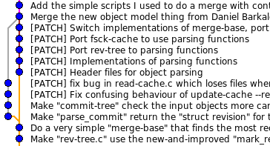
Commands: Making snapshots
git add
working
staging
git commit -a
git commit
staging
snapshot
gitk
...
git log
snapshot
snapshot
/
?
git status
working
staging
Notes:
To move changes from your working directory into the staging area, use “git add”.
To make a new snapshot from the staging area, use “git commit”. Use “git commit -a” to make a new commit directly from all changed files in the working directory.
Use “git log” to get a list of all commits on the current branch.
“gitk” is a nice GUI version of this, that also draws a nice graph of the relationship between commits.
Finally, “git status” gives you a summary of the current staged and unstaged changes.

Slide 52
Commands: Diffing
vs.
git diff
working
staging
vs.
git diff --staged
staging
snapshot
vs.
git diff HEAD
working
snapshot
vs.
git diff <from> <to>
snapshot
snapshot
Notes:
To see the differences between the working directory and the staging area, use “git diff”.
If you want to see the changes scheduled to become the next commit, use “git diff --staged”.
“git diff HEAD” shows you the diff between the working directory and the latest commit.
Finally you can use “git diff <from> <to>” to see the differences between any two commits in the repository.

Slide 53
Commands: Branches & Tags
git branch
git branch <branch>
git checkout <branch>
git tag -l
git tag <tag>
git checkout -b <branch>
Notes:
“git branch” shows a list of your current branches.
“git branch” is also used to create new branches.
Use “git checkout” to switch to a different branch. “git checkout -b” is a handy shortcut when you want to start working on a new branch.
“git tag -l” lists existing tags.
Use “git tag” to create new tags.

Slide 54
Commands: Fetching & Merging
git remote add <name> <URL>
git fetch <name>
git merge <name>/<branch>
git clone <URL> <project>
git pull
git init <project> cd <project> git remote add origin <URL> git fetch origin git checkout master
Notes:
To start talking to another Git repo, use “git remote add”. This gives you a short name used to refer to the other repo (called a “remote”).
Use “git fetch” to fetch the branches from that remote. These are now available in your repo as “<name>/<branch>”, and you can “git log” or “git diff” these branches.
To merge one of these branches into the current branch, use “git merge”.
git pull is a shorthand for those two commands, but don't use it if you don't want to merge.

Slide 55
Summary
Keep this parable in mind
Git is simple and powerful
One more thing:
git reflog
working
math
master
staging
objects
v1.0-maint
drunk
v1.0.1
v1.0
Notes:
As you continue to learn Git, keep this parable in mind. Git is really very simple underneath, and it is this simplicity that makes it so flexible and powerful.
One last thing before you run off to learn all the Git commands: remember that it is almost impossible to lose work that has been committed. Even when you delete a branch, all that’s really happened is that the pointer to that commit has been removed. All of the snapshots are still in the objects directory, you just need to dig up the commit SHA1.
In these cases, look up “git reflog”. It contains a history of what each branch pointed to and in times of crisis, it will save the day.

Slide 56
Where to go next?
Oh My Git!: https://ohmygit.org (an open source game about learning Git)
Git homepage: http://git-scm.com
Pro Git: http://git-scm.com/book
GitHub: http://github.com
Learn Git Branching: https://learngitbranching.js.org
Git Ready: http://gitready.com
Notes:
Here are some resources that you can follow as your next step.
Now, go, and become a Git master!

Slide 57
References
http://tom.preston-werner.com/2009/05/19/the-git-parable.html

